Slide 1



Reto GOT RDouglas
View in Power BI
Last data refresh:
8/24/2022 2:30:31 AM UTC
Downloaded at:
10/10/2024 1:22:17 AM UTC

Slide 2
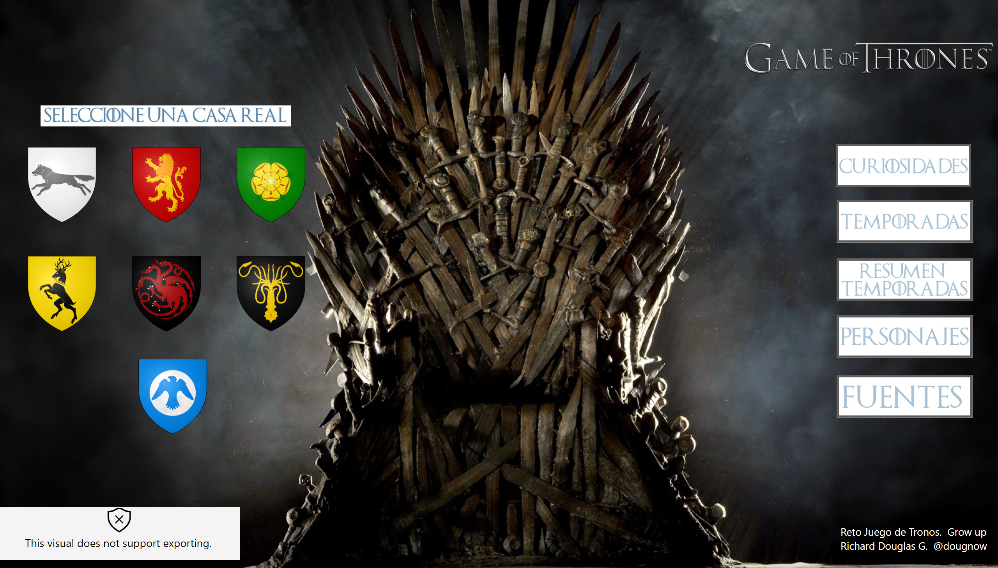
Portada
Notes:
textbox
No alt text provided
image
No alt text provided
image
No alt text provided
image
No alt text provided
image
No alt text provided
image
No alt text provided
image
No alt text provided
image
No alt text provided
actionButton
No alt text provided
actionButton
No alt text provided
actionButton
No alt text provided
htmlContent443BE3AD55E043BF878BED274D3A6855
No alt text provided
actionButton
No alt text provided
actionButton
No alt text provided
image
No alt text provided
image
No alt text provided

Slide 3
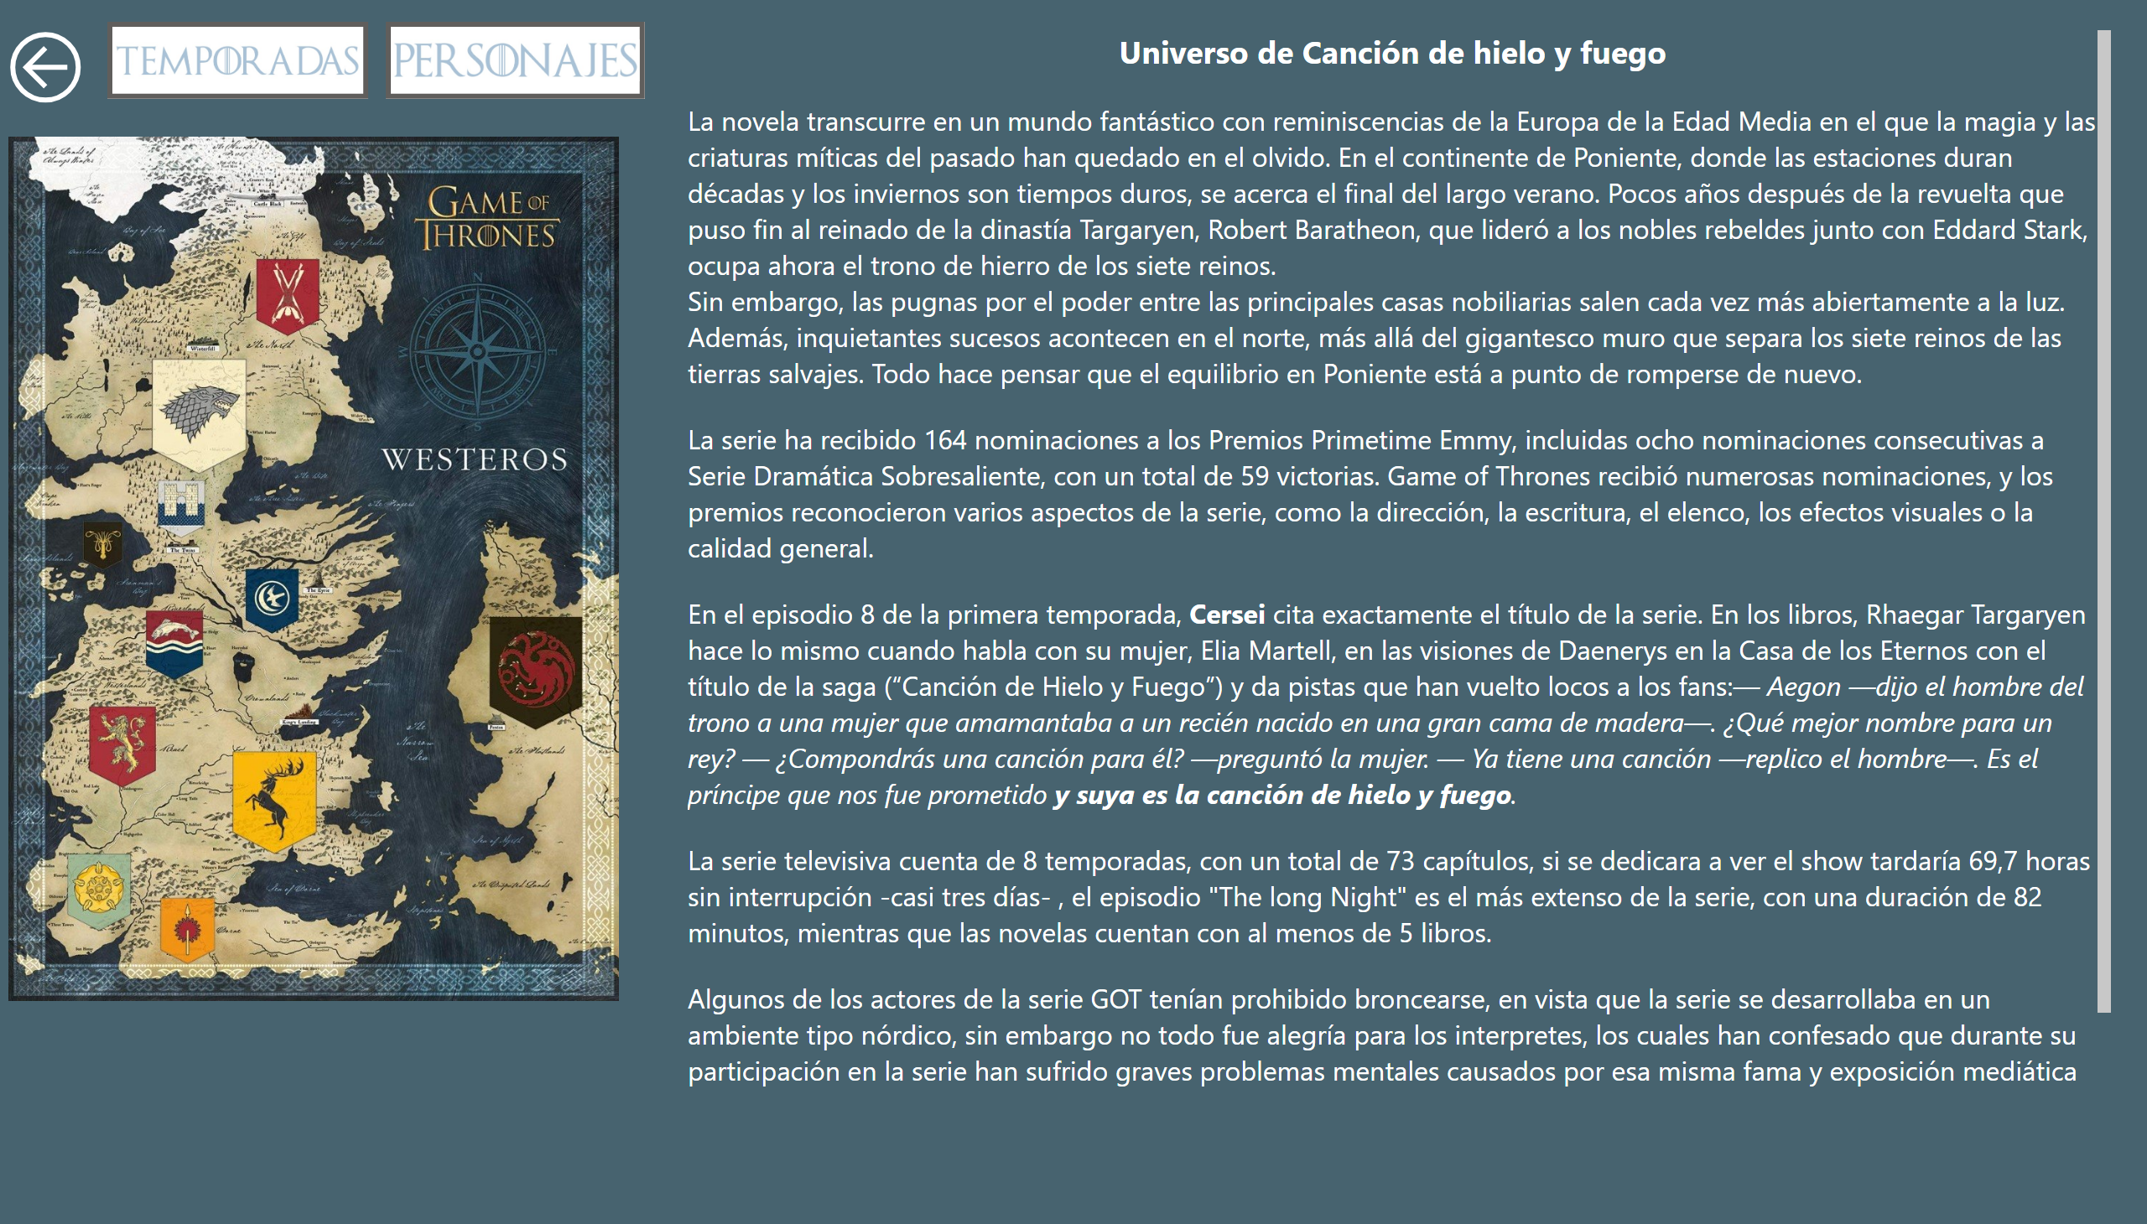
curiosidades
Notes:
textbox
No alt text provided
image
No alt text provided
actionButton
No alt text provided
actionButton
No alt text provided
actionButton
No alt text provided

Slide 4
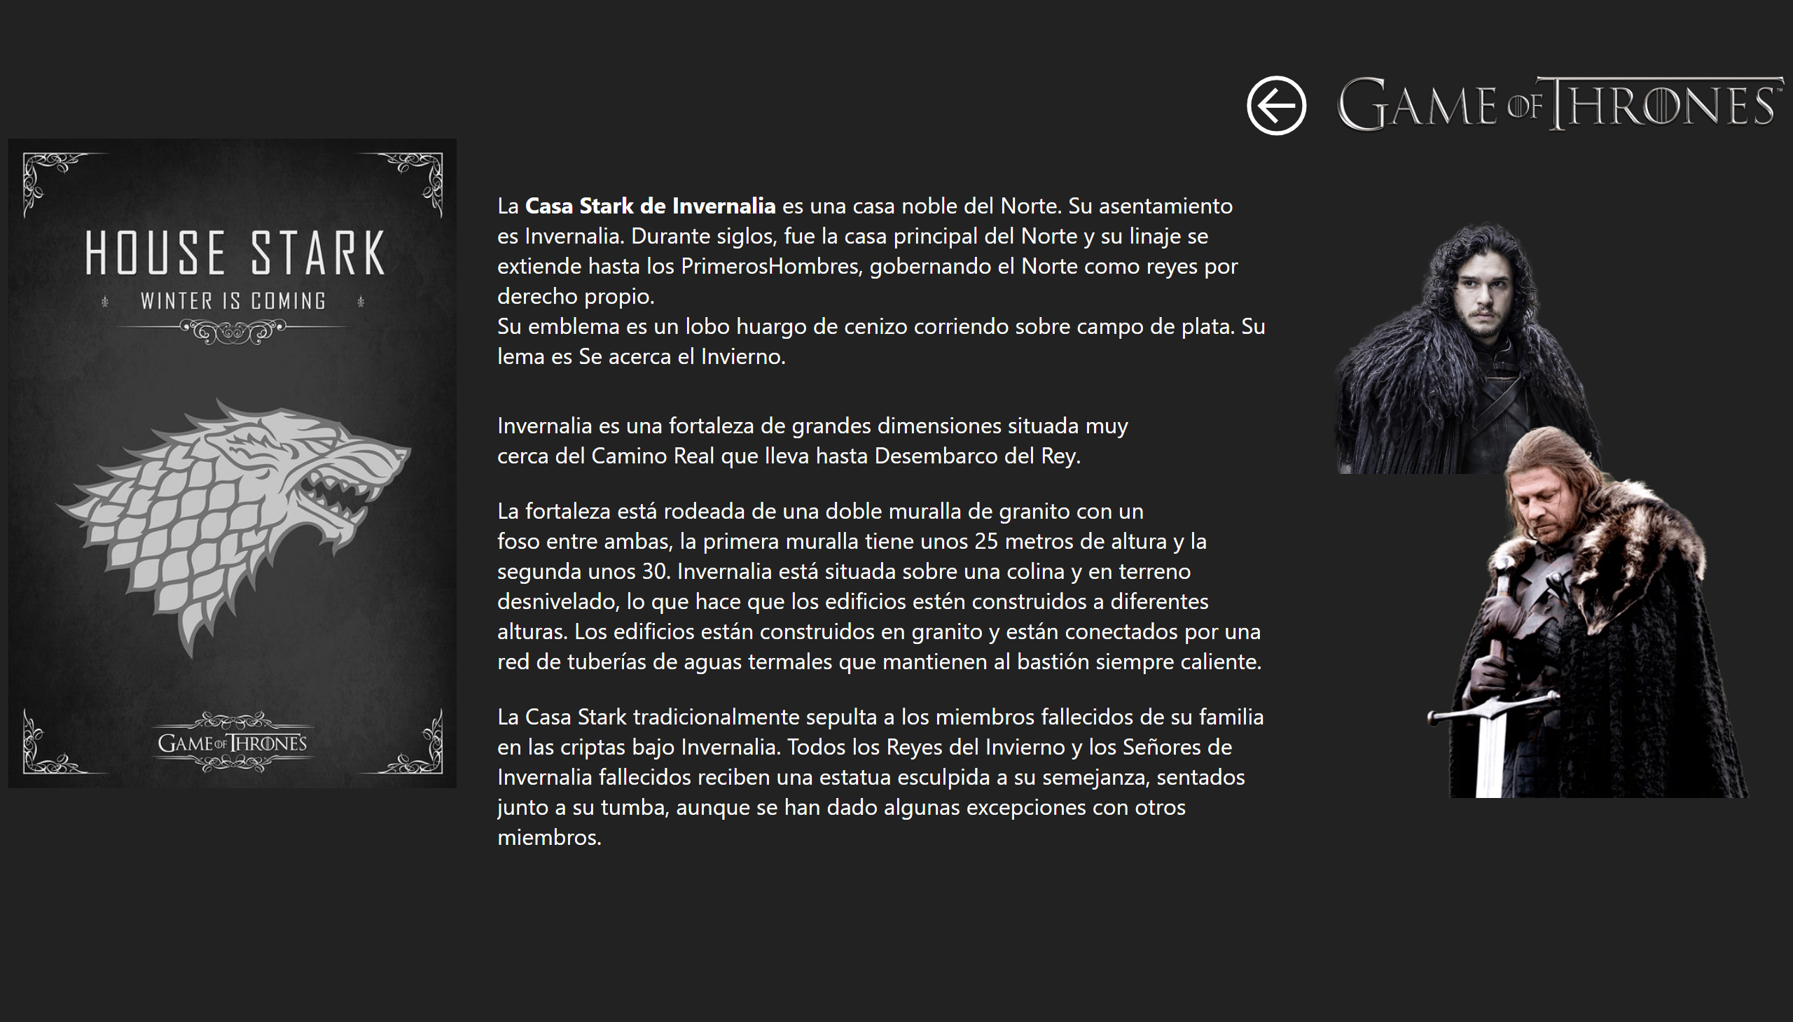
Stark
Notes:
image
No alt text provided
textbox
No alt text provided
image
No alt text provided
textbox
No alt text provided
image
No alt text provided
image
No alt text provided
actionButton
No alt text provided

Slide 5
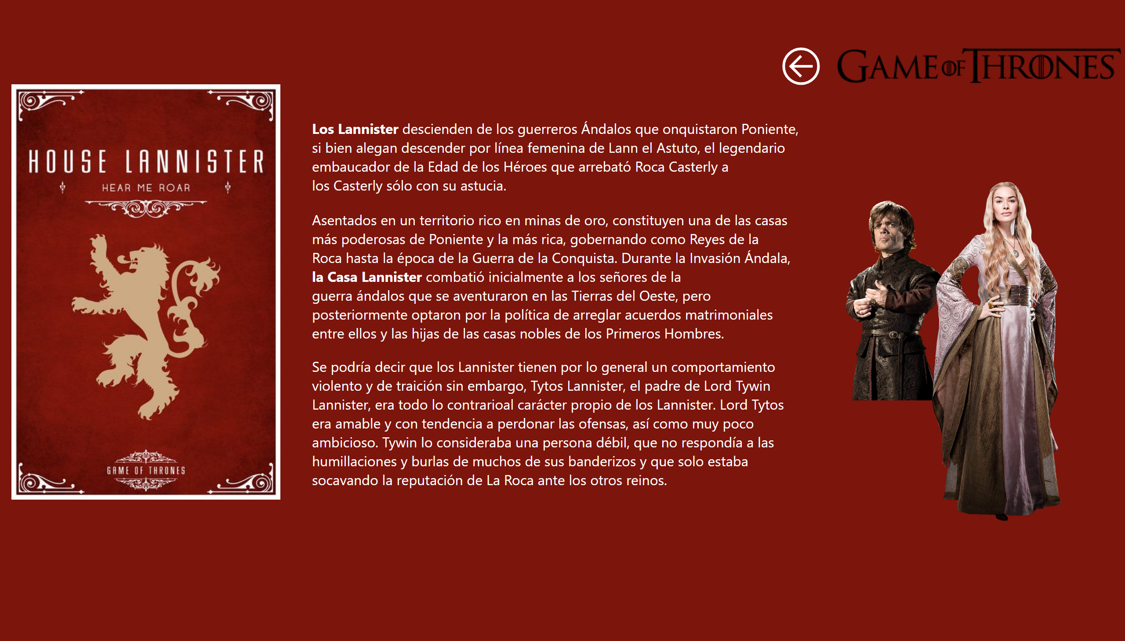
Lannister
Notes:
image
No alt text provided
image
No alt text provided
textbox
No alt text provided
image
No alt text provided
image
No alt text provided
textbox
No alt text provided
actionButton
No alt text provided

Slide 6
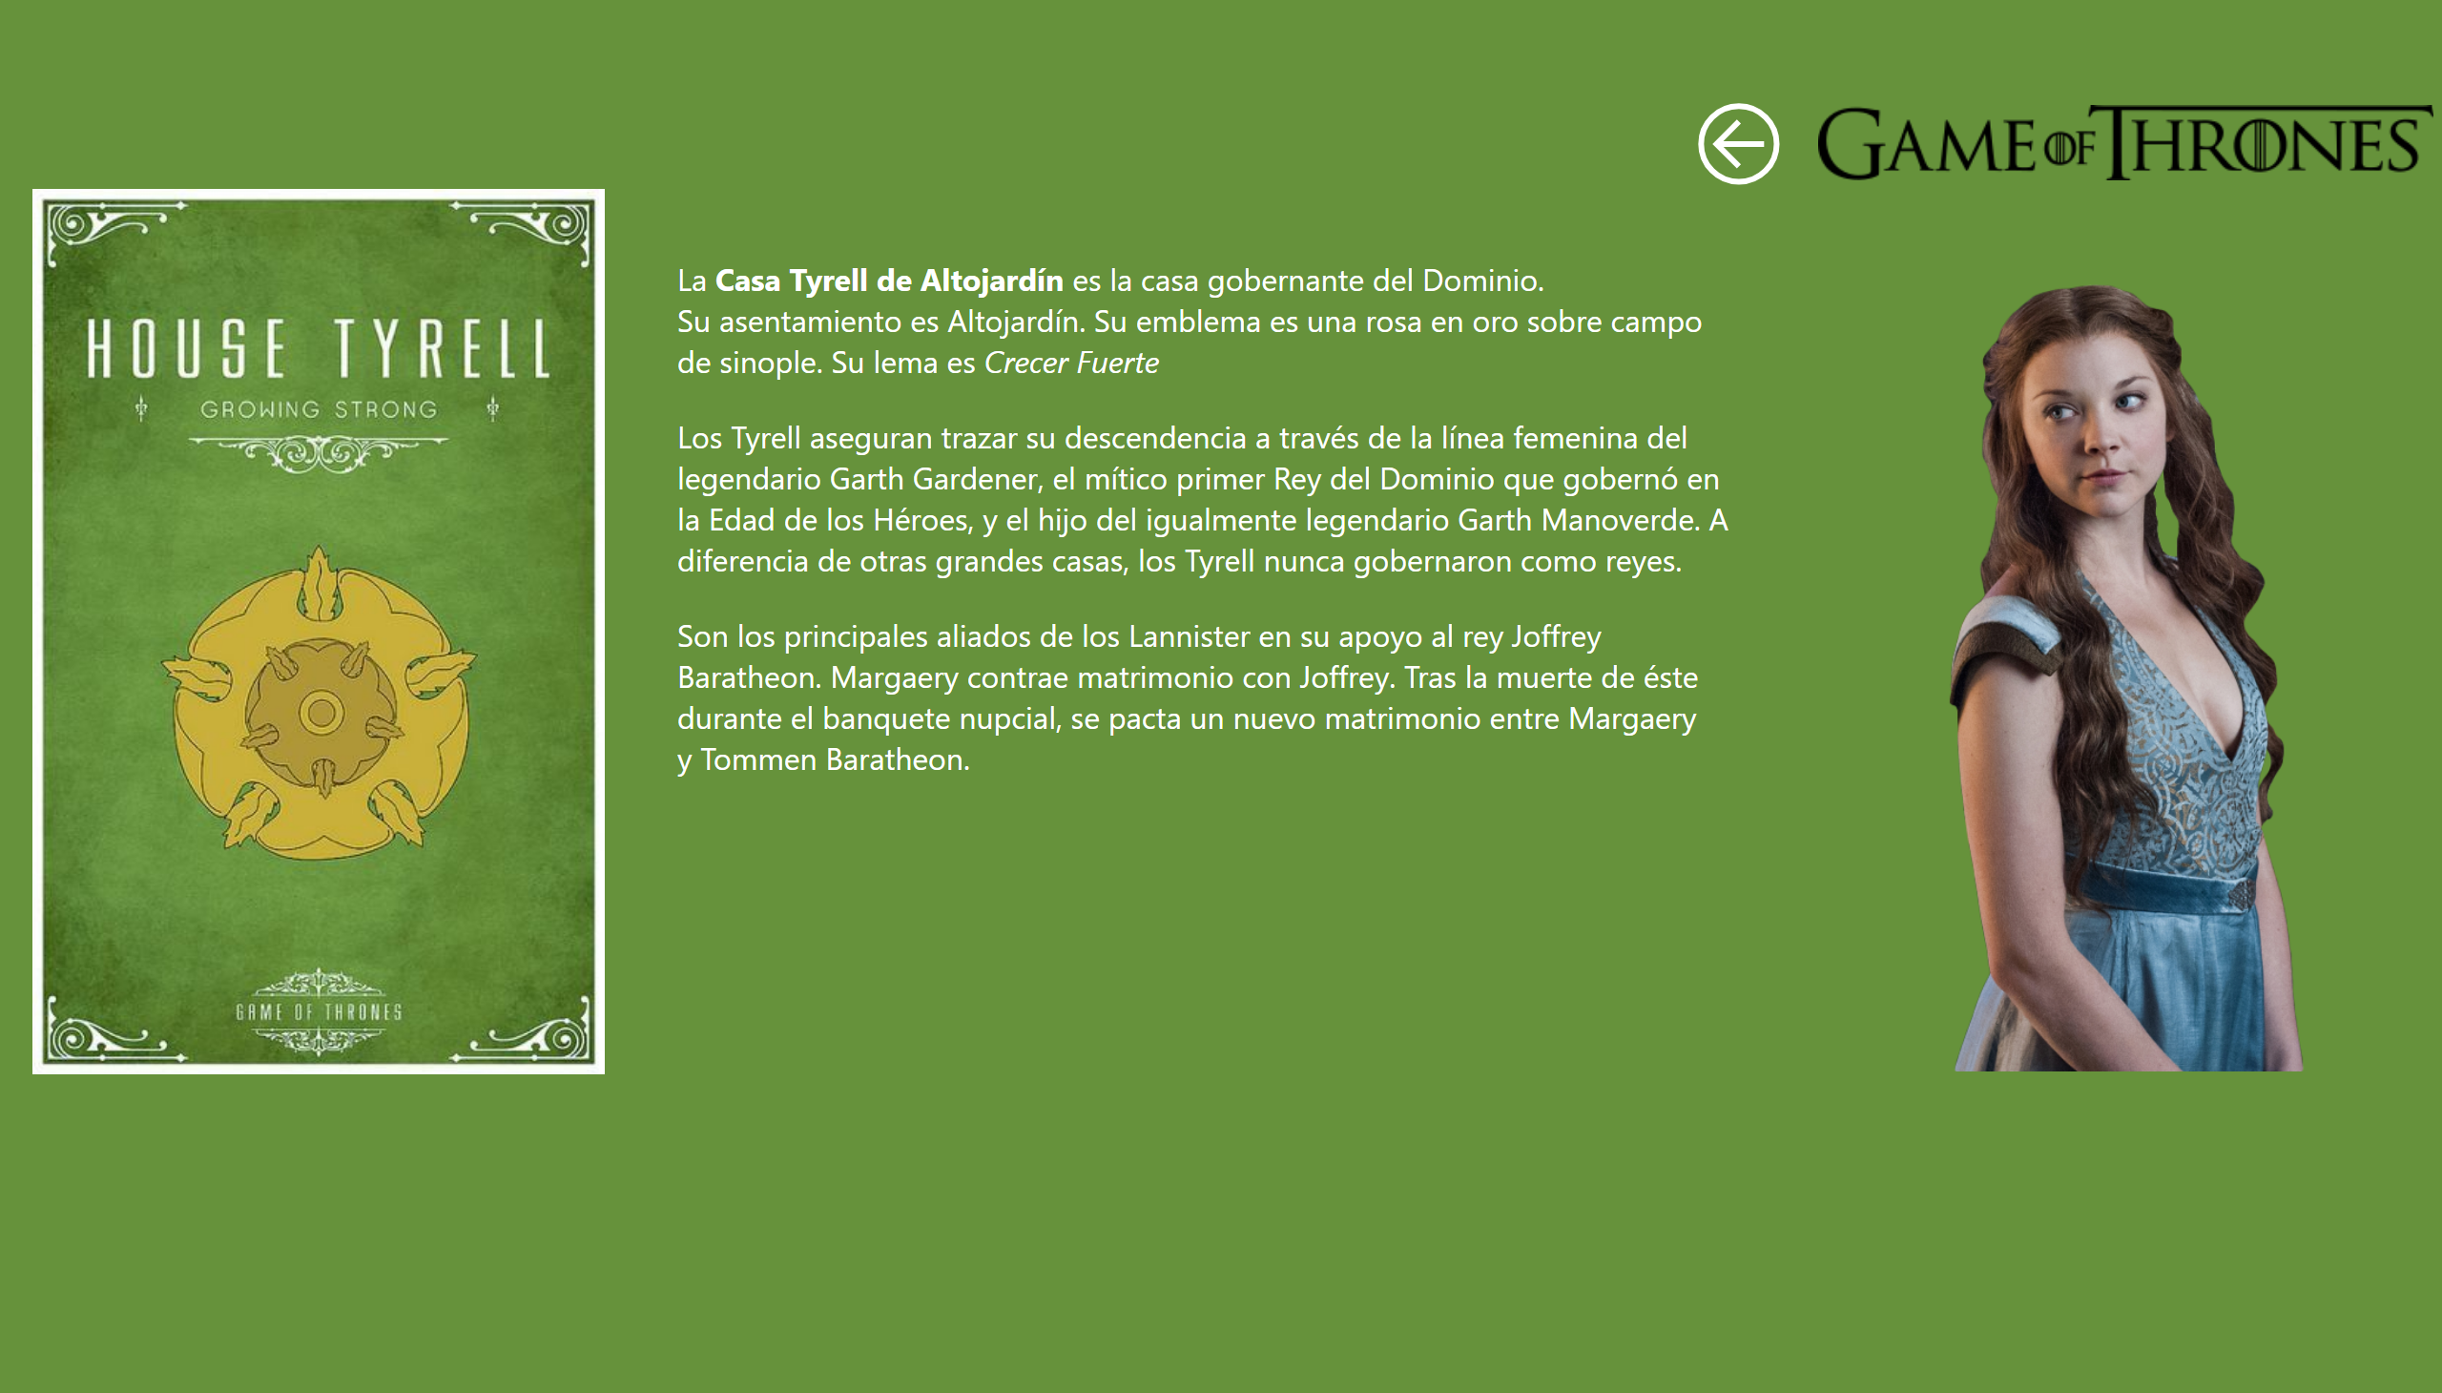
Tyrell
Notes:
image
No alt text provided
image
No alt text provided
textbox
No alt text provided
image
No alt text provided
actionButton
No alt text provided

Slide 7
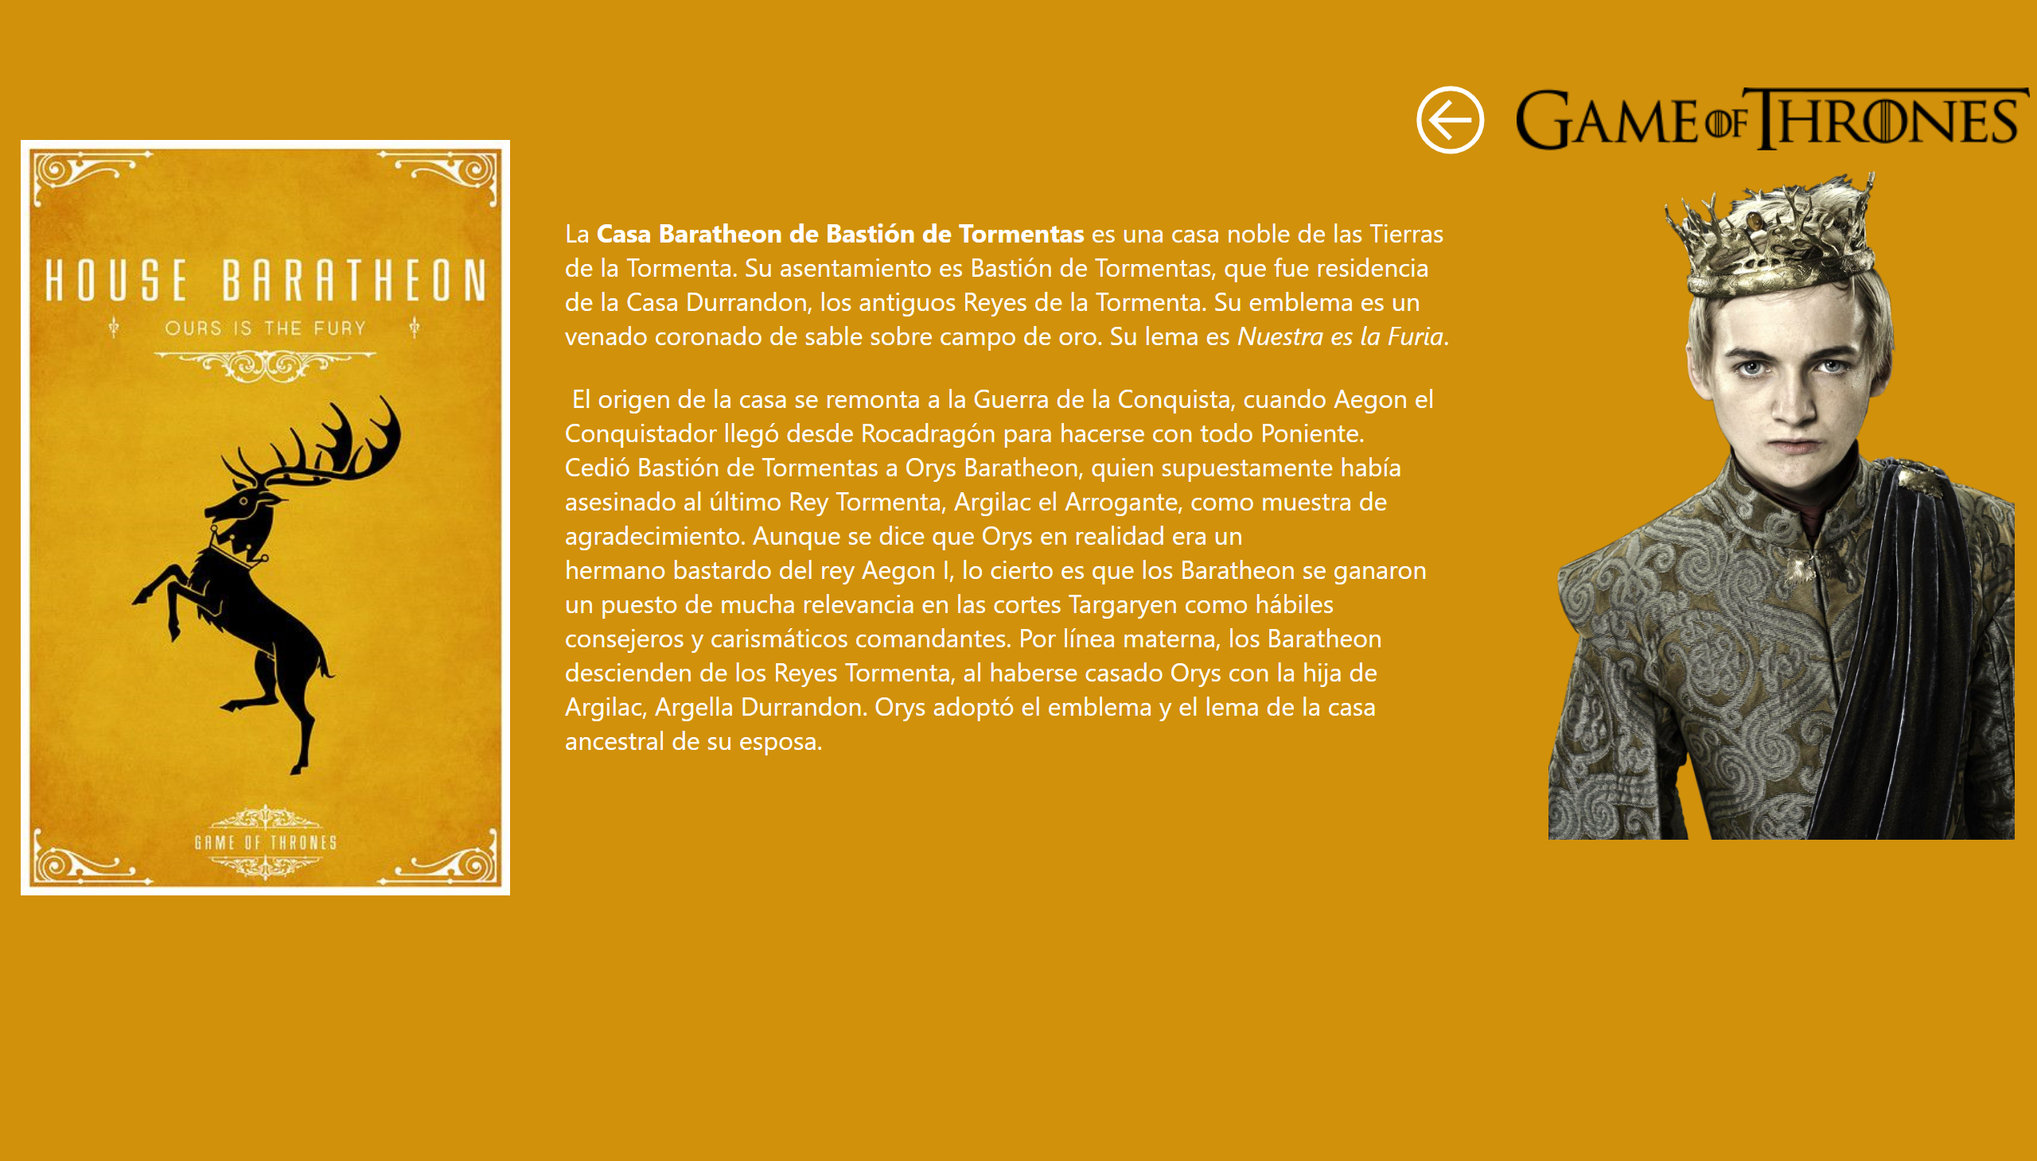
Baratheon
Notes:
image
No alt text provided
image
No alt text provided
textbox
No alt text provided
image
No alt text provided
actionButton
No alt text provided

Slide 8
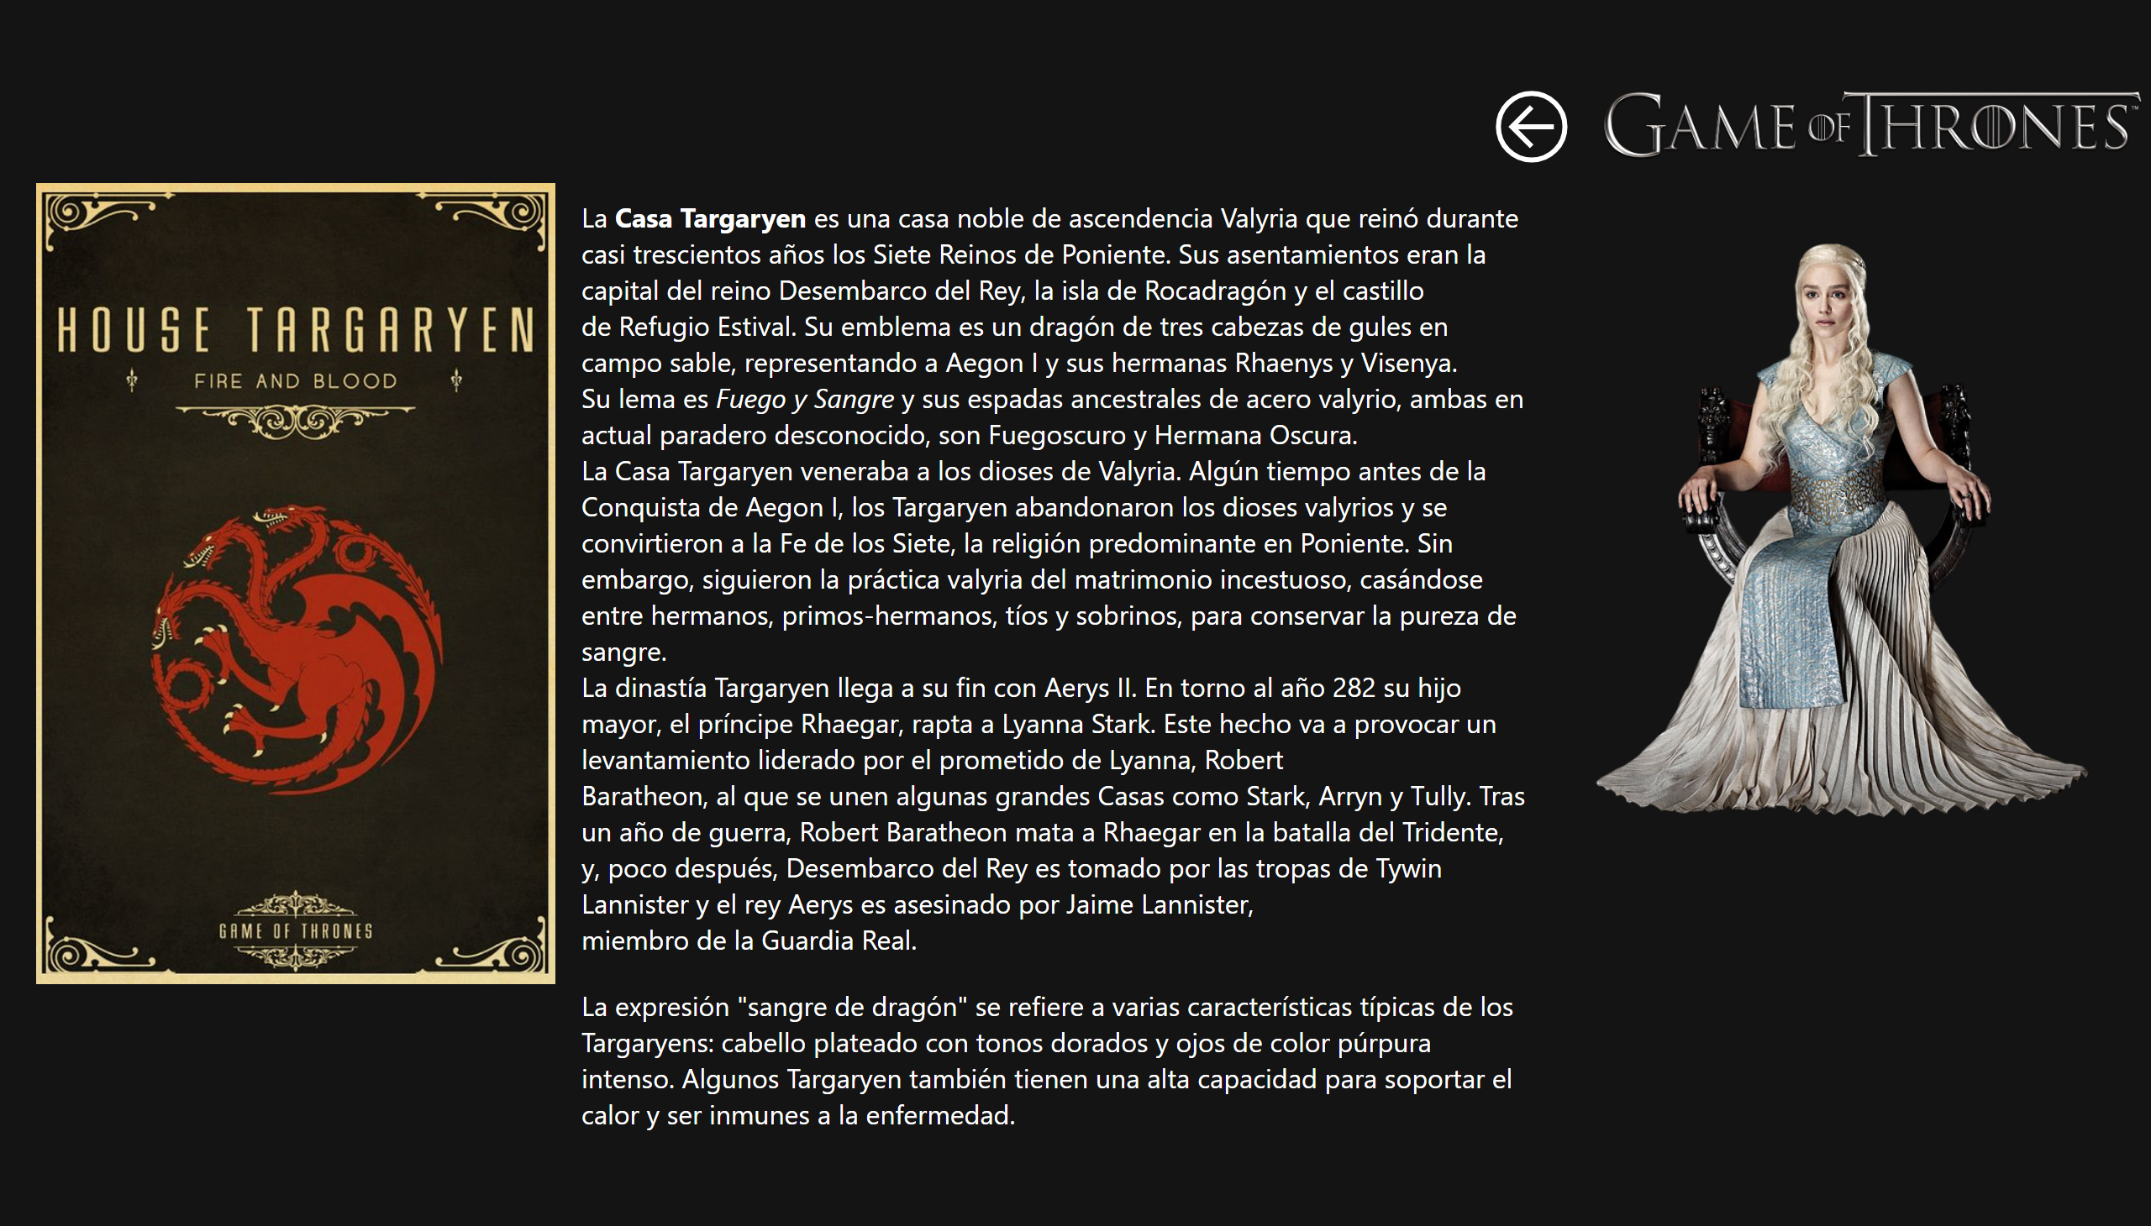
Targaryen
Notes:
image
No alt text provided
image
No alt text provided
textbox
No alt text provided
image
No alt text provided
actionButton
No alt text provided

Slide 9
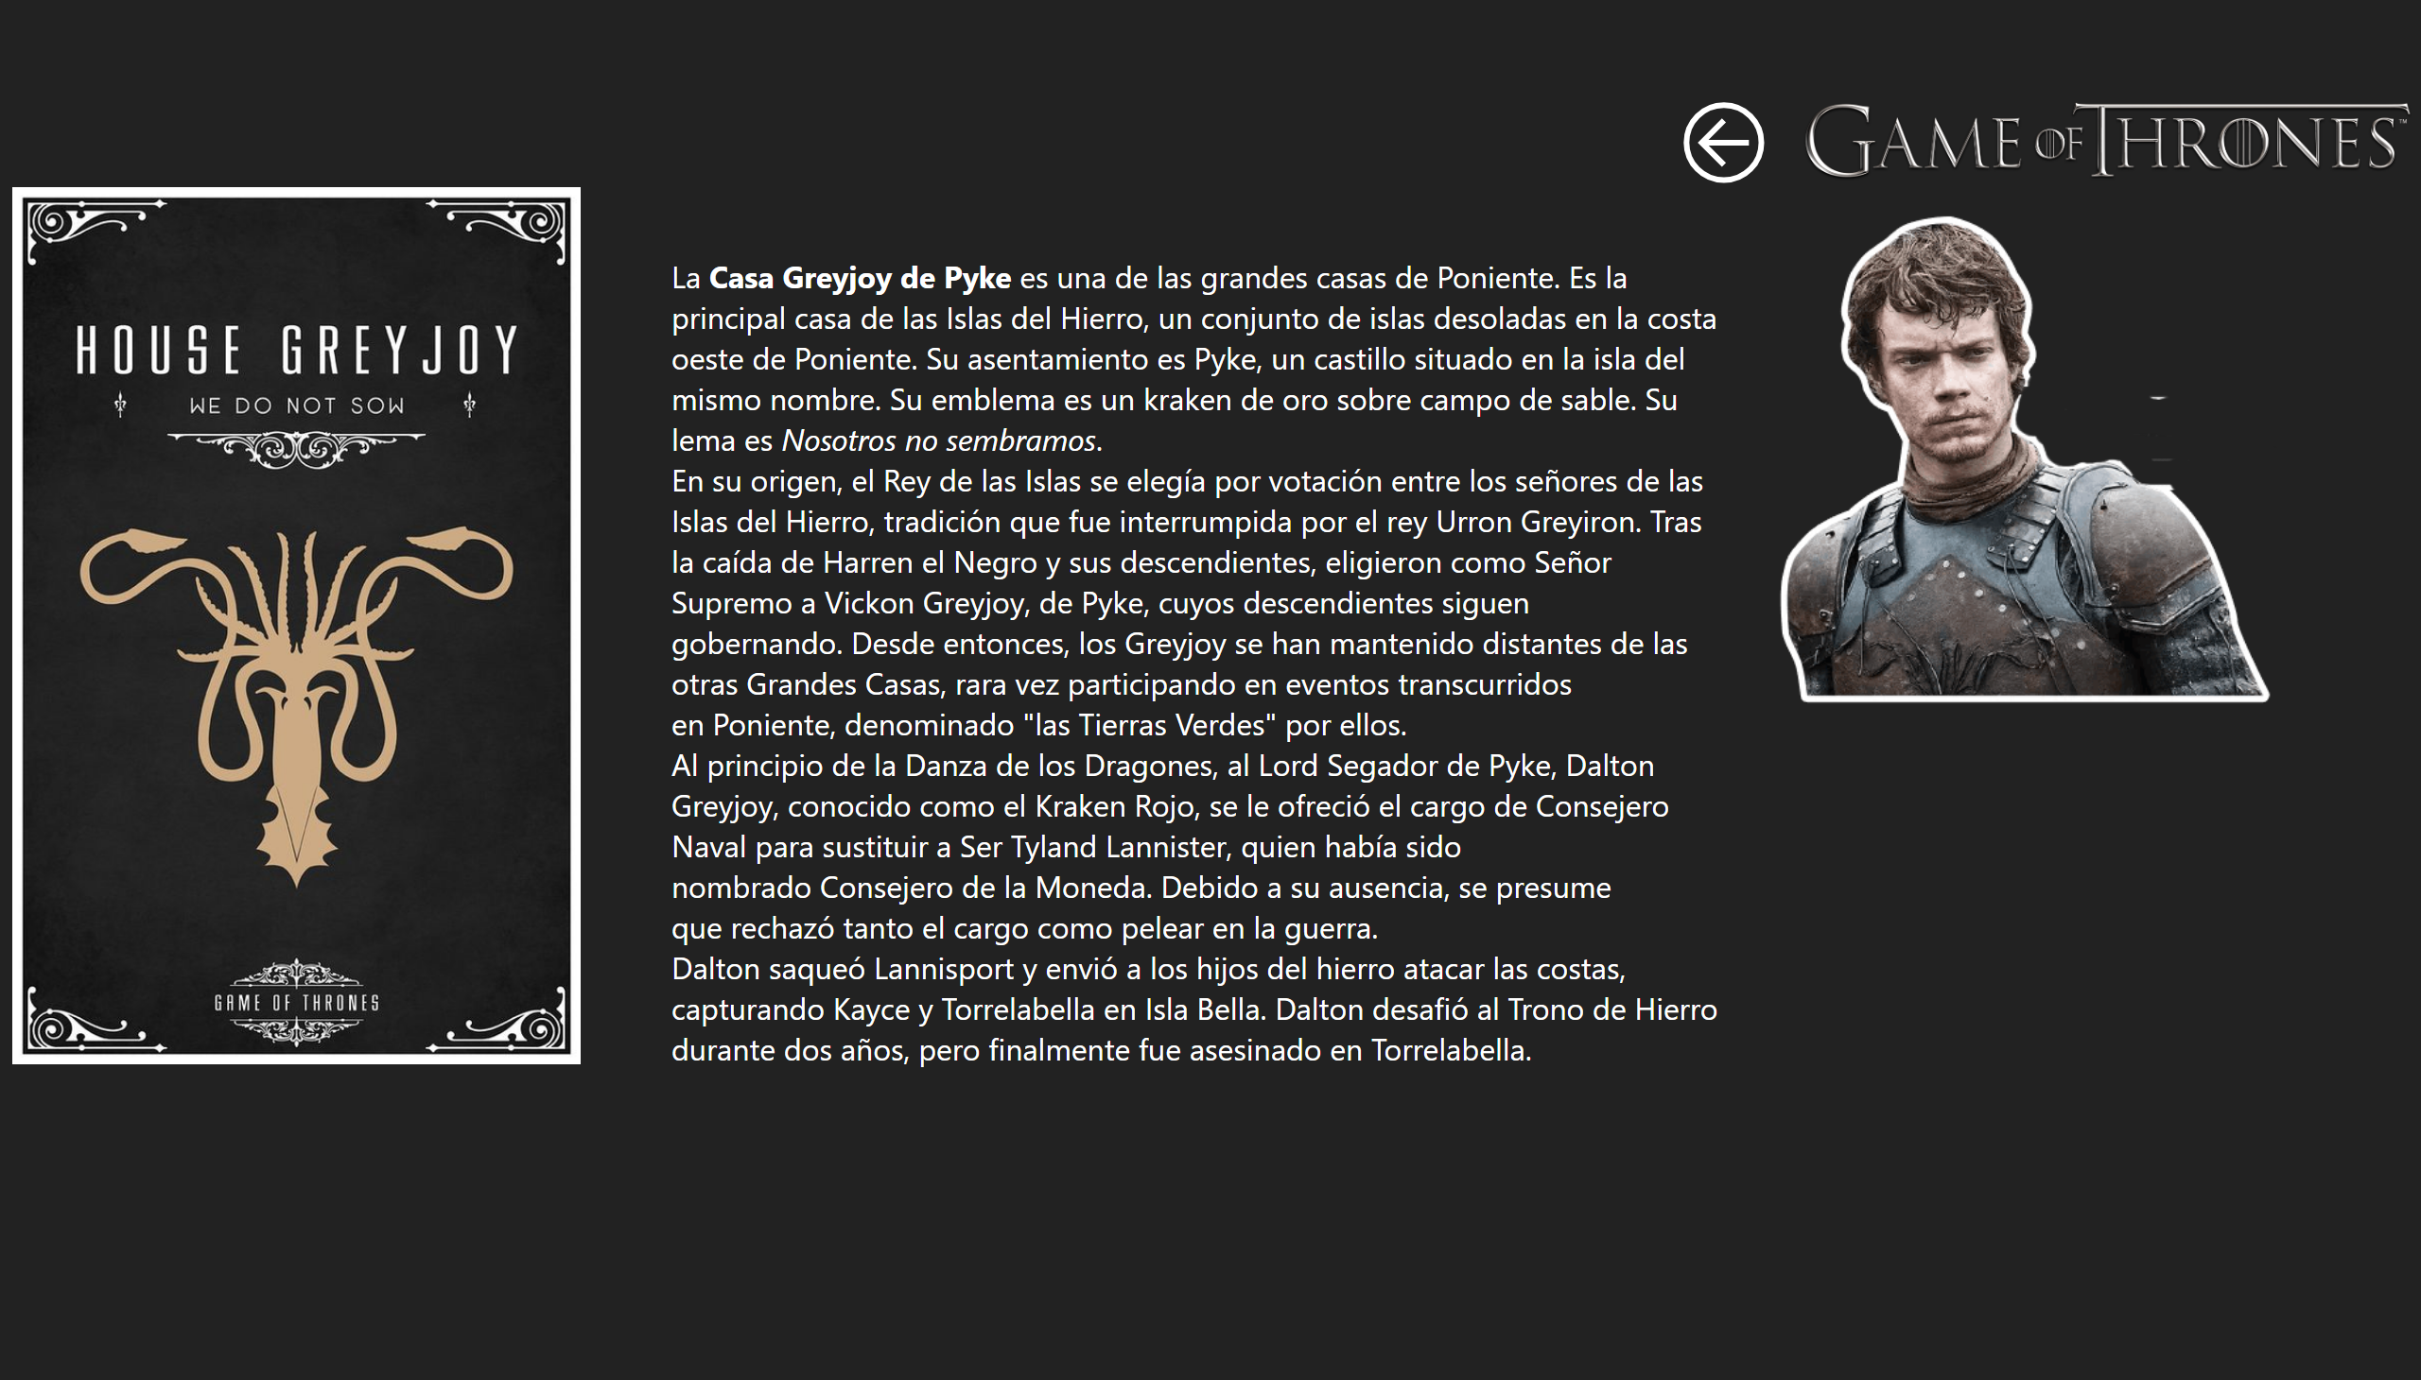
Greyjoy
Notes:
image
No alt text provided
image
No alt text provided
textbox
No alt text provided
image
No alt text provided
actionButton
No alt text provided

Slide 10
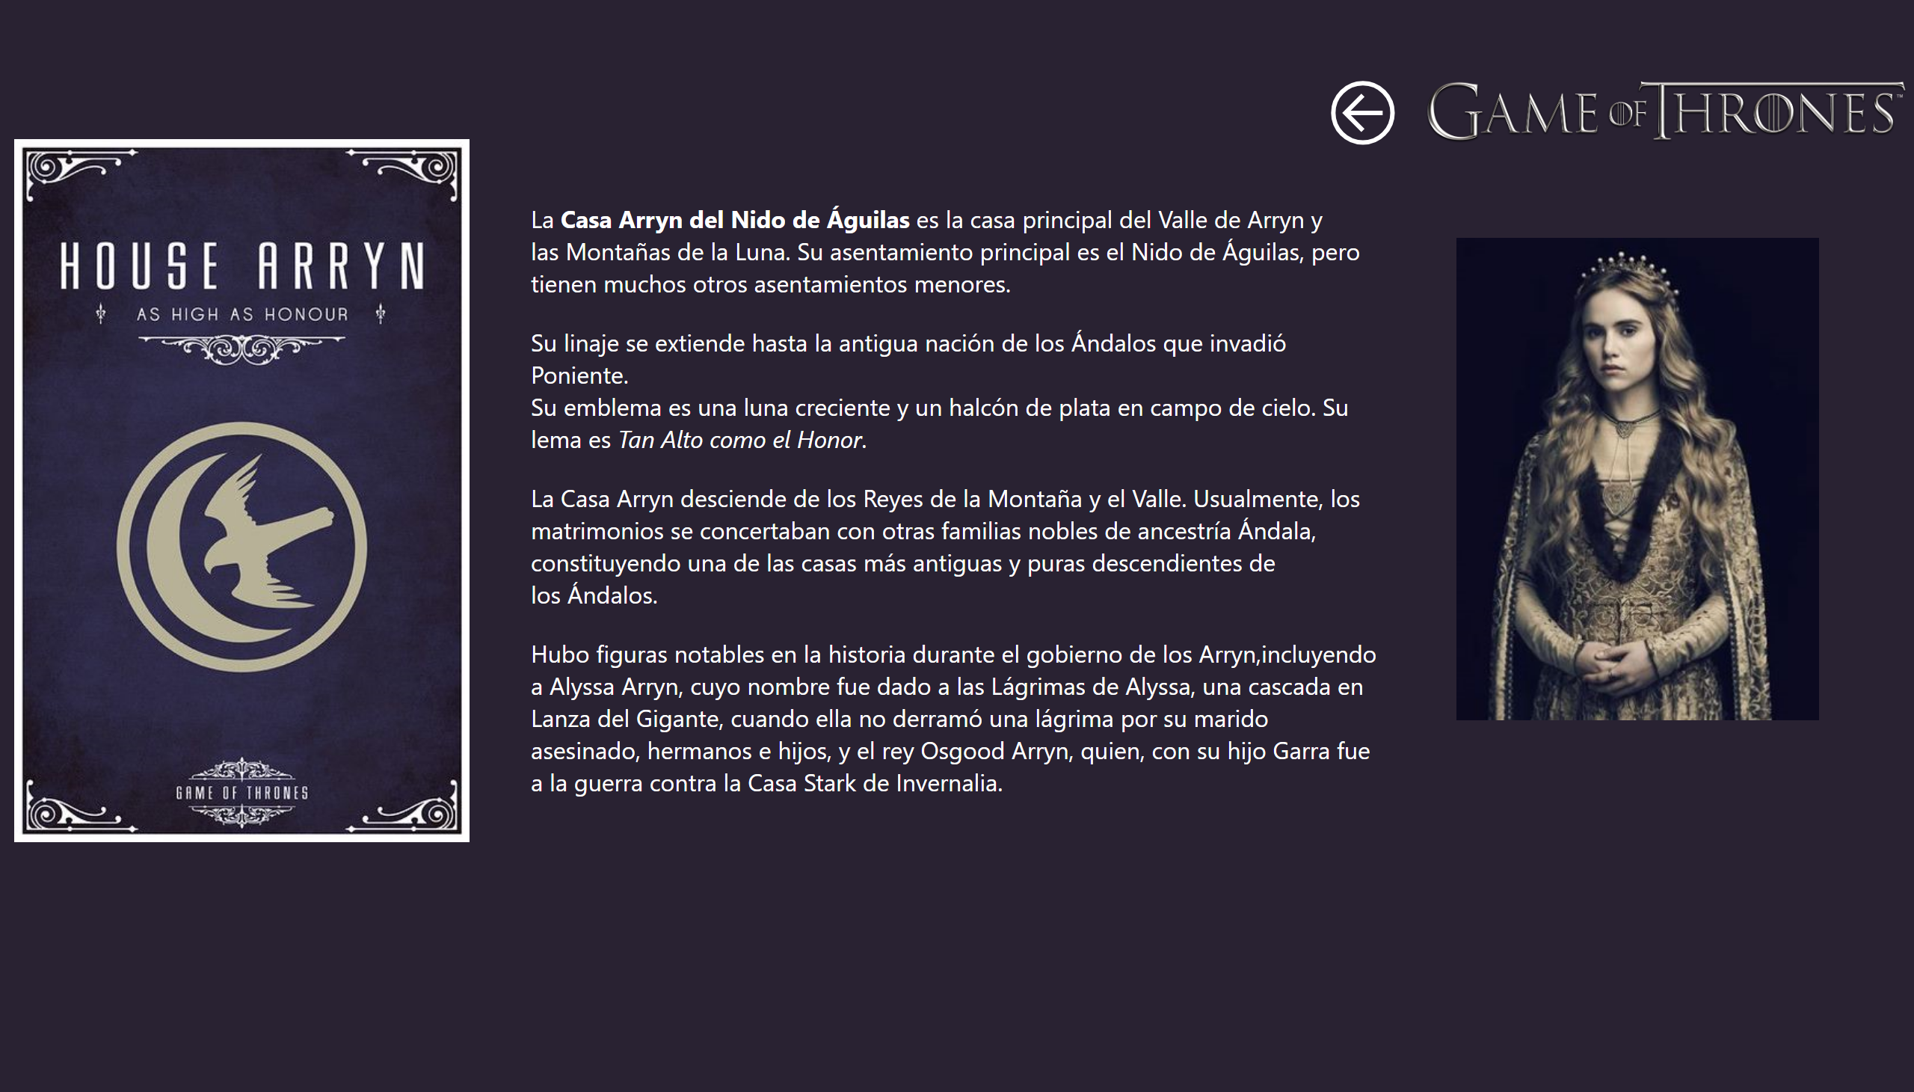
Arryn
Notes:
image
No alt text provided
image
No alt text provided
textbox
No alt text provided
image
No alt text provided
actionButton
No alt text provided

Slide 11
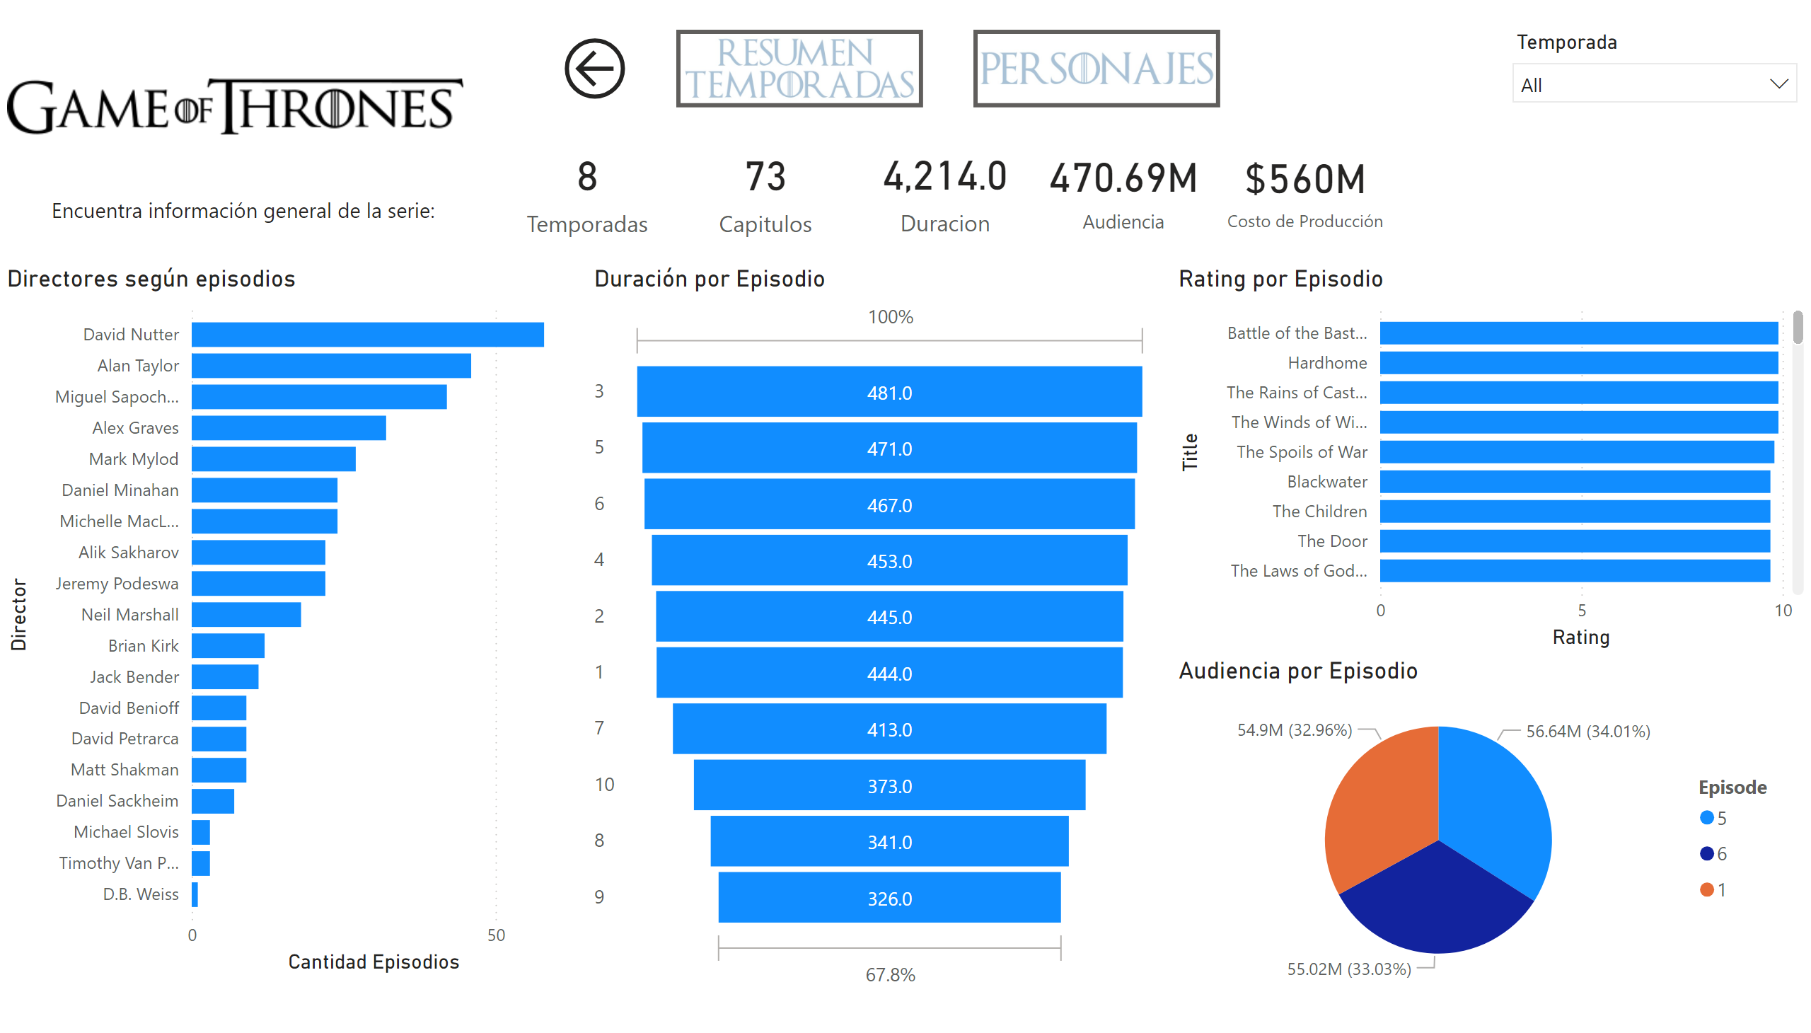
Series
Notes:
Rating por Episodio
No alt text provided
slicer
No alt text provided
Directores según episodios
No alt text provided
image
No alt text provided
card
No alt text provided
card
No alt text provided
card
No alt text provided
card
No alt text provided
card
No alt text provided
Duración por Episodio
No alt text provided
Audiencia por Episodio
No alt text provided
actionButton
No alt text provided
actionButton
No alt text provided
actionButton
No alt text provided
textbox
No alt text provided

Slide 12
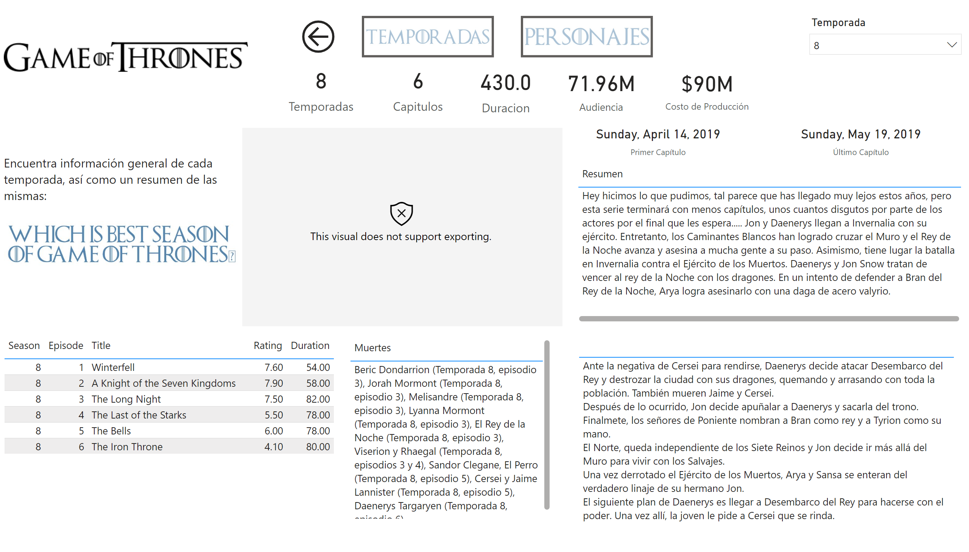
temporadas
Notes:
tableEx
No alt text provided
slicer
No alt text provided
image
No alt text provided
card
No alt text provided
card
No alt text provided
card
No alt text provided
card
No alt text provided
card
No alt text provided
card
No alt text provided
card
No alt text provided
tableEx
No alt text provided
tableEx
No alt text provided
tableEx
No alt text provided
simpleImageEBC4593F96F1425FB3D84C5BF02B5075
No alt text provided
image
No alt text provided
textbox
No alt text provided
actionButton
No alt text provided
actionButton
No alt text provided
actionButton
No alt text provided

Slide 13
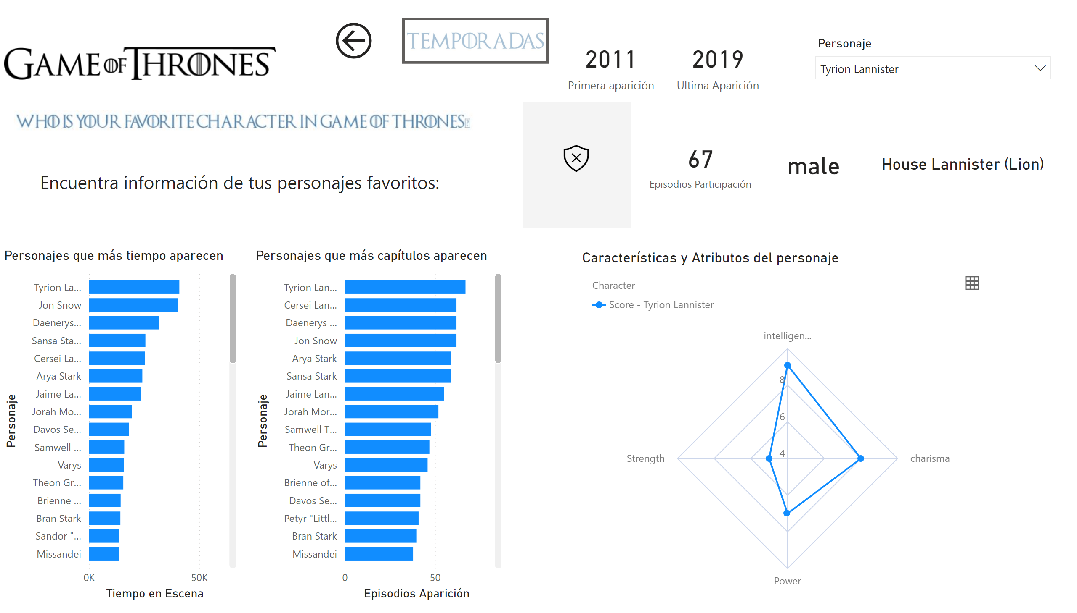
Personajes
Notes:
Características y Atributos del personaje
No alt text provided
slicer
No alt text provided
image
No alt text provided
Personajes que más tiempo aparecen
No alt text provided
Personajes que más capítulos aparecen
No alt text provided
card
No alt text provided
card
No alt text provided
card
No alt text provided
card
No alt text provided
card
No alt text provided
simpleImageEBC4593F96F1425FB3D84C5BF02B5075
No alt text provided
image
No alt text provided
textbox
No alt text provided
actionButton
No alt text provided
actionButton
No alt text provided

Slide 14
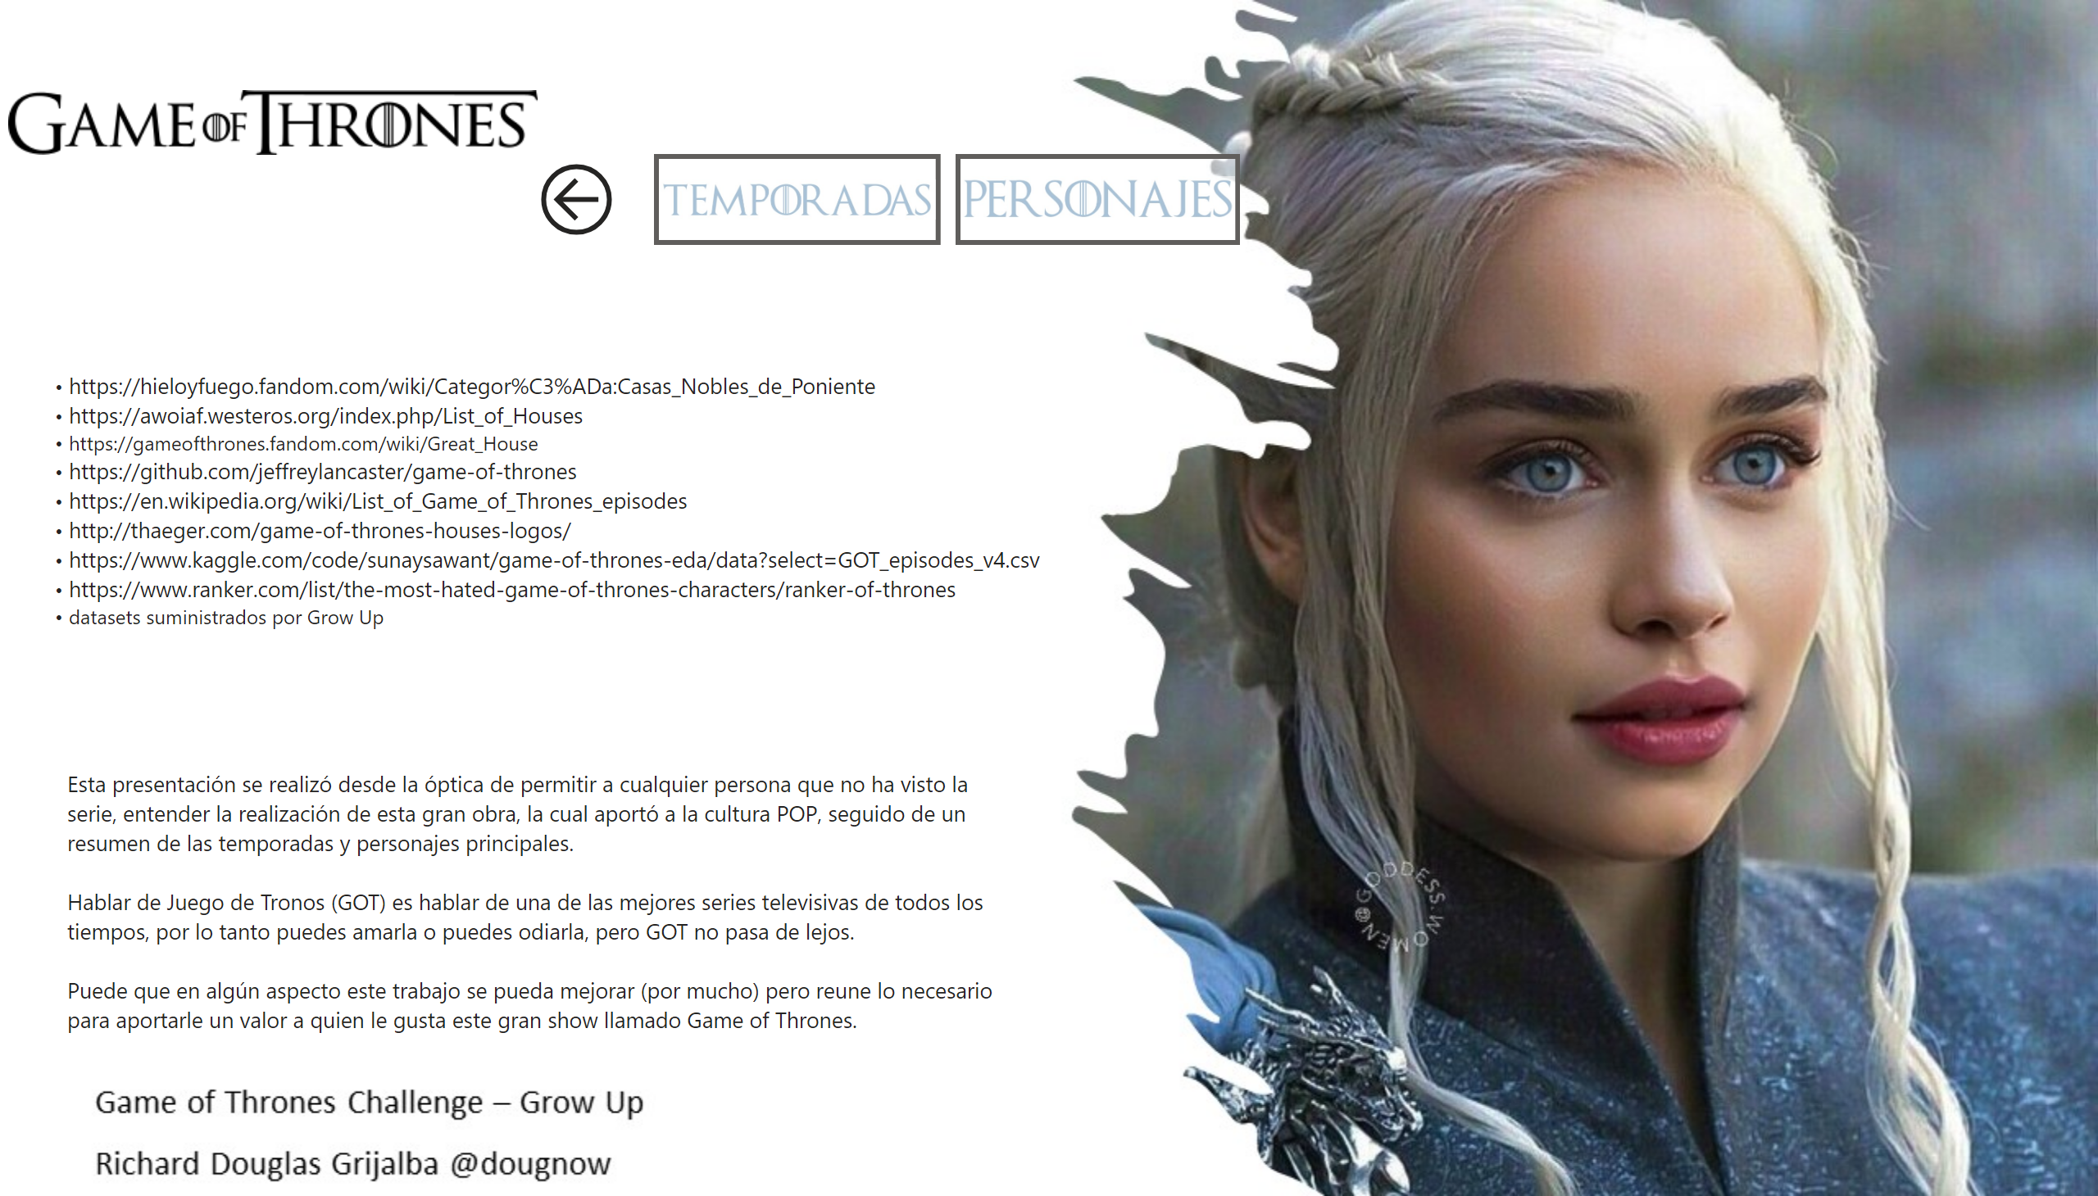
Fuentes
Notes:
textbox
No alt text provided
image
No alt text provided
actionButton
No alt text provided
actionButton
No alt text provided
actionButton
No alt text provided
textbox
No alt text provided

